Slide 1
ITSC 203:
Offensive and Defensive Tool Construction
Module 2: Advanced features of Python
Notes:
1

Slide 2
User Input
For scripts to be interactive there needs to be a 'method' for users to provide input. This input can be used to start, change the flow of or terminate the program.
Python makes this simple with the built-in method "input". See below for examples of possible uses:
>>> number = input("Please enter a number: ")
>>> number
'345'
>>> name = input("Please enter a name: ")
>>> name
"<Students Name>"
>>> help(input) # What does help say about the return value of input?
You should do some research on this function
https://docs.python.org/3/library/functions.html
What is the type of the value returned from the function input?

Slide 3
Other User Input
The sys module provides a way for the script to take input from the command line instead of interactively. More on this later, see below for a brief example:
import sys
print(sys.argv[0])
print(sys.argv[1])
print(len(sys.argv))
To see this in action create a test script.
The sys module makes use of the STDIN, STDOUT and STDERR streams.

Slide 4
Command-line Challenge
Write a program that will take the following commandline and generate the output below:
prompt_me$ mycmdline 5 + 7 - 20 / 5
prompt_me$ 8
No loops are required but if you know how to do this with loops you may proceed.

Slide 5
Flow Control and Loops
Up this point all code has been executed sequentially. Based on experience this is not realistic when dealing with more advanced, complicated or useful programs.
Python provides the following controls and loops:
if,else, elif # Does Python use switch or ternary operations?
for
while
break
continue
IMPORTANT:
Indentation is an important delimiter in Python. It is used to demark the body of all blocks of code. It must be consistent throughout the entire script. You can use either SPACES or TABS. Not both and it "MUST BE" the same from beginning to end of script.

Slide 6
If …
General format of the if statement:
if <condition is true>:
# perform task
Example 1:
if value == 10:
print("The value is 10")
Example 2:
if value == 10 and value2 == "This is a string":
print("The value is 10 and string is \"This is a string\"")
Example 3:
if value not in [10, 20, 30, 60] or value2.startswith("This"):
print("value was found or \"This\" started the string in value2")

Slide 7
If … Challenge
Write a python script that will determine if a user entered string contains the word ‘credible’. If the entered string contains the word return that the string was found and the offset of the string. Example output:
Please enter a string: This is the most credible source I could find.
Found the string "credible" at location: 17
Write a python script that will generate a list of the first 100 numbers and print them only if those numbers are even and don’t have a 3 or 7 in that number. Example output:
[0, 2, 4, 6, 8, 10, 12, 14, 16, 18, 20, 22, 24, 26, 28, 40, 42, 44, 46, 48, 50, 52, 54, 56, 58, 60, 62, 64, 66, 68, 80, 82, 84, 86, 88, 90, 92, 94, 96, 98]

Slide 8
if … else?
General format of the if statement:
if <condition is true>:
# perform task
else:
# perform this task instead
Example 1:
if value == 10:
print("The value is 10")
else:
print("The value is not 10")
Example 2:
if value == 10 and value2 == "This is a string":
print("The value is 10 and string is \"This is a string\"")
else:
print("The value is not 10 and or string is not \"This is a string\"")

Slide 9
if … elif … else?
General format of the if statement:
if <condition is true>:
# perform task
elif <condition is true>:
# perform this instead
else:
# perform this as a final solution
Example 1:
if value == 10 and value2 == "This is a string":
print("The value is 10 and string is \"This is a string\"")
elif value == 15:
print("The value is 15, see => ", value)
else:
print("The value is not 10 and or string is not \"This is a string\"")
What happens if we use parentheses around the conditions?
Does the approach change the meaning?
Example: if((value ==10) and (value2 == "This is a string")):

Slide 10
For loops
For loops allow execution of code to repeat until a condition is met. The format is as follows:
for <condition is true>:
# perform task
if <condition is true>:
# perform these statements
Example 1:
for value in range(20):
print("Range values are: ", value)
if value % 2 == 0:
print(f"\tRange value {value} is also even")
Example 2:
list1 = [10, 203, 50, 10, 30, 33, 10, 15, 23, 22]
for value in list1:
if( value // 10 > 0 and value % 10 < 5):
print("Value: ", value, " value//10: ", value/10, " value%5 " , value%5)
Notes:
Jan 27, 2021

Slide 11
While …
While loops are another staple of many programming languages. The while loop also provides a mechanism to execute the same code multiple times. The general format is as follows
while <condition is true>:
# perform task
if <condition is true>:
# perform these statements
Example 1:
count = 0
while True:
if count == 10:
print(count)
break
elif count % 6 == 0:
count += 2
continue

Slide 12
While vs For loop
According the python wiki “https://wiki.python.org/moin/ForLoop”
For loops are used when you have a fixed number of iterations
While loops are used when you will repeat a sequence until a condition is met.
Example showing for loop running until all numbers in the range are printed:
for nums in range(0, 100, 2):
print(nums)
Example showing while loop running until the user enters 10:
userinput = 100;
while userinput != 10:
userinput = input('Enter a number please: ‘)
print(f'You entered: {userinput}')

Slide 13
Comprehension
Python is a constantly evolving language and as such you will find that there are interesting ways being developed to enhance, fix or replace a previously used approach to solve a problem.
The creation of comprehension is such an attempt to speed up or reimagine the way that loops work.
Lets investigate the list comprehension to understand this process:
Imagine that you wanted to create a list of number from 1 to 100. Using a for loop that would look like the following:
>>> list1 = [ ] # Create an empty list
>>> for nums in range(1, 101): # Use a for loop to fill in the list with values from 1 to 100 inclusive
... list1.append(nums)
...
>>> list1 # Confirm that the values were placed into the list
[1, 2, 3, 4, 5, 6, 7, 8, 9, 10, 11 …]

Slide 14

List Comprehension
That process consisted of 2 line of code.
The list comprehension way of doing this is as follows:
>>> list2 = [num for num in range(1, 101)]
>>> list2
[1, 2, 3, 4, 5, 6, 7, 8, 9, 10 … ]
The simplicity of the 1 line above is awesome but takes a bit of time to comprehend[sion]!!!
Evaluate the following examples to get a better sense of how they work
list3 = [x**2 for x in range(1, 200, 2) if (x % 2 == 0)]
list4 = [x**2 for x in range(1, 200, 2)]
list5 = [len(str(x**2)) for x in range(1, 200) if (x % 2 == 1)]

Slide 15
Comprehension
As a challenge investigate the concept of comprehension as it relates to:
Tuples
Dictionary
Set
Does the concept of comprehension help or hinder?
Are there any scenarios where they can be useful?
What do the following statements do?
tupl_comprehension = (val for val in range(100, 150, 10) if val%30 == 0)
dict_comprehension = {val:str(val) for val in range(100, 150, 10) if val%3 == 0}
set_comprehension = {val for val in range(0, 200, 10)}
For more information: Comprehensions in Python - GeeksforGeeks

Slide 16
Functions
Functions provide a way to create function blocks that can be repeated many times. Python supercharges functions beyond this and also allows those very function to be easily called from other scripts. By importing other scripts in a format known as a module you can use any, well defined, function within the path.
The format for a function is as follows:
def functionname(parameter list):
#body of the function
# possible return value(s)

Slide 17
Functions
Example1:
def sumfunc(val1, val2):
return val1 + val2
Example2:
def sumfunc(list_ints):
added = sum(list_ints)
return added, len(list_ints)
Example3:
def xorfunc(list_ints, new_list, val2):
"""This function will perform an xor on the list_ints with val2
and return the original and new list after being sorted"""
for val in list_ints:
new_list.append(val ^ val2)
return sorted(list_ints), sorted(new_list)

Slide 18
Functions - Challenge
Create the file func1.py with the following code and explain what is happening:
def xorfunc(list_ints, val2):
"""This function will perform an xor on the list_ints with val2
and return the original and new list after being sorted"""
new_list = []
for val in list_ints:
new_list.append(val ^ val2)
return sorted(list_ints), sorted(new_list)
print(help(xorfunc))
b = xorfunc([10, 20, 50, 78, 45, 40], 0x34)
print(f'Printing b: {b}’)
a, b = xorfunc([10, 20, 50, 78, 45, 40], 0x34)
print(f'Printing a and b: {a} and {b}’)
There is some small redundancy in the code. How could this be resolved?
a, b = xorfunc([10, 20, 50, 78, 45, 40], 0x34)

Slide 19
Functions - Challenge
On the previous slide, the following line needs a bit of clarity.
Do you know what is happening here and what the process is called?
a, b = xorfunc([10, 20, 50, 78, 45, 40], 0x34)

Slide 20
Functions
Note:
When we called the function we used positional arguments. That means that the list [10, 20, 50, 78, 45, 40] will always get placed into the variable list_ints and therefore 0x34 will always get placed into the variable val2. The reason is they are assigned that way because of the position.
Positional arguments are always required.
Functions in python also have the ability to assigned by keyword arguments, these are variables have a default value and are therefore optional. More explanation to follow.

Slide 21
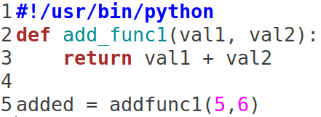
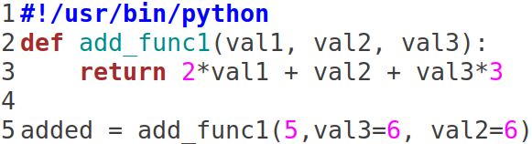
Functions – Positional arguments
Python allows the use of position name when calling a function.
If a function has a parameter list, it allows for arguments to be sent to the function.
When a function is called; the values being sent to the function are positionally assigned. In the snippet of code below that means val1 = 5 and val2 = 6.
Python allows you to specifically use the parameter name to assign values. This allows the arguments to be explicitly set. Also, the values to be called in any order as shown below. As long as non-positional arguments come first.
In other words this will generate an SyntaxError because 5 is incorrectly placed: added = add_func1( val3 = 8, 5, val2 = 7 ) # Give it a try

Slide 22
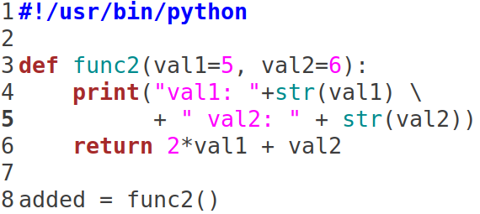
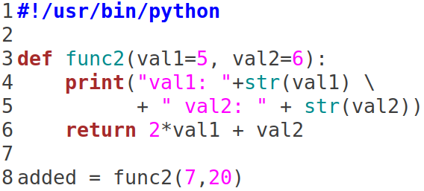
Functions – Default values
Python allows the use of default values in the parameter list of the function.
This can be quite handy when dealing with functions that should generate a value regardless of its input. A so called default state.
When a function is called; the values being sent to the function are positionally assigned. In the snippet of code, on the left, the function is called without any values assigned to the parameters. It will use the default values.
The second time the function is called it is given the value 7 and 20, this is despite the default values of 5 and 6 already set. These arguments are also called keyword arguments.

Slide 23
Functions – Where is main … ?
Where is main and why is it not needed? Looking at the code below, it is unclear where to start.
The python interpreter operates sequentially:
It compiles the code into bytecode, then loads it into memory to be executed.
Execution begins at the first line and continues from there sequentially.
The keyword def tells the interpreter load this function into memory and it expects to find instructions associated with the function after.
It finally gets to the function call func2(7,20) on line 8 and since it recently created a function on line 3 it knows where in memory to find it and executes that bit of code.
Completes its job and returns to the shell after the last instruction.

Slide 24
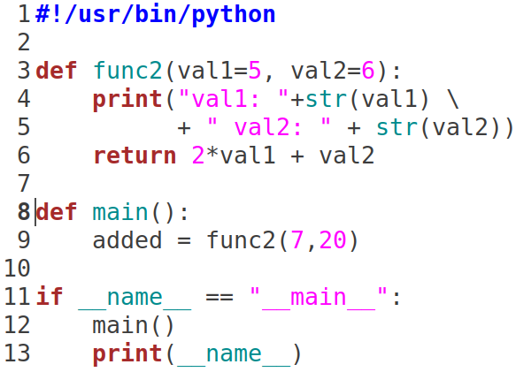
Function – Let them have main …
There is a way to recreate that main feeling …
The code below shows the approach:
Challenge:
Can you explain what is happening?
Why does this work and what is it doing?

Slide 25
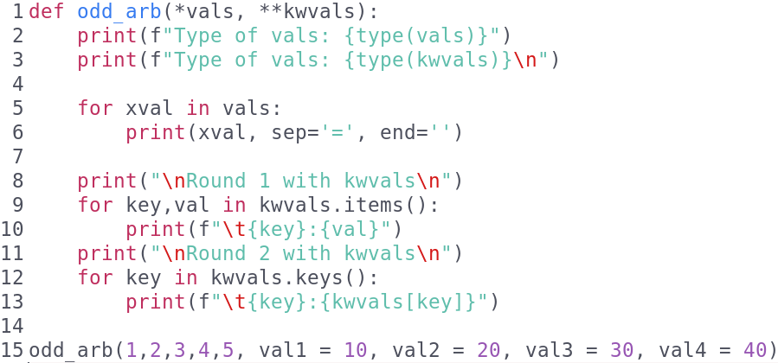
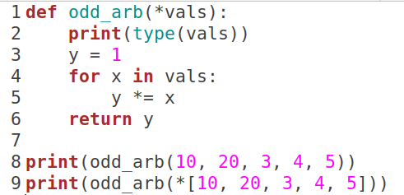
Functions – Arbitrary List
There are times when we don't know how many positional or keyword arguments we will be sending to the function. In such a case we can use the Arbitrary List feature of Python. See the example below:
Do a bit of research and determine what lines 8 and 9 are doing?

Slide 26
Challenge
Write a python script that has the following features:
5 Functions
Addition
Subtraction
Division
Factorial
XOR
Print out a menu representing each of the options
If the user doesn't enter all the parameters use a default value of 0, 1 in the case of division function.
Print out the values of each operation.

Slide 27
Functions – Built-in
Python has some interesting built-in functions that provide some interesting results.
Take a look at:
map: you have a list and want to apply a function to each element
enumerate: You have a list and want to create counter to each element
zip: you have 2 list with first names and last names and want to combine them
lambda: You want to create a simple function, like an inline function
There are other functions like this, but this is a good start. They are not always needed but can be a good tool to use in a pinch.
Google search to get more information:
python geeksforgeeks <function you are curious about>

Slide 28
Objectify A Class …?
What is a Class?
What is an Object?
Have we used either in python so far?
Try the following lines in the interpreter:
>>> str_obj1 = "I am a string object"
>>> type(str_obj1)
>>> dir(str_obj1)
>>> int_obj1 = "I am an integer object"
>>> type(int_obj1)
>>> dir(int_obj1)
Python has plenty of objects to support many of the possible functionality needed by a programmer. It goes beyond that and allows for the modification of those features as well.

Slide 29
Object Oriented
Python is object oriented, which means it has the ability to do the following:
Encapsulate
Bind together data and function
Take multiple forms (polymorphism)
Functionality with same name behave differently
Inheritance
Takes on features of other objects
For more about object oriented programming:
https://en.wikipedia.org/wiki/Object-oriented_programming

Slide 30
Object Oriented
Terms:
Class
Blueprint
Instance (instantiation)
Object
Method
Attributes
Initialize
Getters
Setters

Slide 31
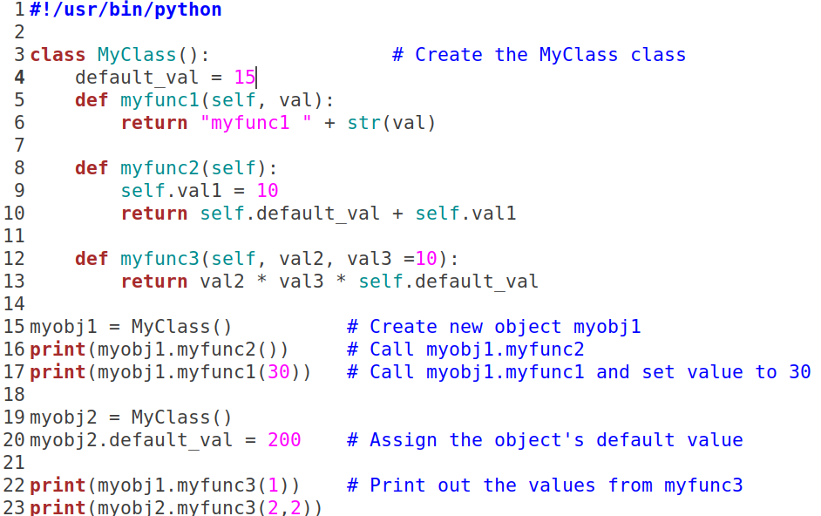
Class
Analyze the following code, determine the expected output.
Consider investigating self and __init__

Slide 32
Class – More examples
For those of you who are animal lovers, we know that there are many types of dogs. Despite this fact we also know that each dog barring any mutation will have minimally: 4 legs, 1 head (complete with eyes, mouth etc), 1 tail, usually 1 name etc
We can go out on a limb here and even say that these dogs will perform the following actions: bark, walk, run and lick the face of its favorite person.
These attributes and actions provide a blueprint from which we can build our computer dog. That is our instance representing a dog.
Using this information create a class that represent a Dog.
You should do the following:
Create a run function that prints running when called
Create a bark function that prints barking when called
Create an info function that provides the dogs attributes described below.
When the dog is instantiated you will set the following attributes provided by the user:
Name, age, breed, Energy level, Number of tricks

Slide 33
Class – More examples
For most of us going through this program, our aim after finishing the program is become an employee and a wonderful job somewhere.
As employees we have attributes:
Name
Department
Salary
Identification
Position
We also have skills/actions that we can perform
Write Code: When function called will print “I am a hacker/developer”
Info: Provides a table showing the attributes of the Employee.
Raise: Updates the yearly salary by the percentage value provided.
Take into consideration the above information and create a class called employee.

Slide 34
Files
Accessing files in python is quite easy. The built-in function to do is called open. The format for open is as follows: open("<filename>", "<mode")
Example:
>>> file_handle = open("myfirstfile.txt", "r")
Investigate and determine the available functions for the new object file_handle.
How would you open a file for the following modes?
Writing
Appending
Reading and Writing
Seek to arbitrary locations.
Is there a mode for binary operation?
Can 1, X or all lines in the file be read or written at a time?
X represents and arbitrary number

Slide 35
Files – other ways
Are there other ways to open a file and manipulate its content?
>>> for lines in open('class1.py','r'):
... print(lines)
...
The Context Manager with is the most convenient way of working with files as it opens and automatically closes the file after leaving the context manager.
Investigate how to open a file using the with operator
>>> with open('class1.py', 'r') as fhandle:
... print("First line: %s"% fhandle.readline())
...
First line: #!/usr/bin/python
What are the above lines doing?
How would you determine if the file is still open?

Slide 36
Exceptions
Your code from time to time will misbehave. You need a way to ensure that it recovers cleanly without creating more problems than it intended to solve. The errors that may cause the program to fail are generally produced from user input or from another application being investigated. The likely reason is that the program produced unexpected results or output.
Python provides a mechanism to recover or better yet capture that information so that it can be analyze. The most common sequence you will find are as follows:
try: # Perform some action read, write, calculate etc
except: # If there was a problem attempt to resolve or gracefully exit
finally: # Always do this, this bit is optional
Python also permits you to raise your own exception using the raise keyword. This comes in handy when you detect an error in the way your code performs that isn’t a system error.

Slide 37
Exception - example
>>> try:
... 5/0
... except:
... print("There was a problem in the try block")
... finally:
... print("Always do this")
...
There was a problem in the try block
Always do this
>>> try:
... 5/1
... except:
... print("There was a problem in the try block")
... finally:
... print("Always do this")
...
5.0
Always do this

Slide 38
Exception - example
Write a program that will get the user the enter a filename. If the user made a mistake and entered the name of a file that doesn’t exist. Instead of allowing the traceback errors from a failure to open a non-existent file you will use the try except block to print a simpler message: Your file "filename.txt" doesn’t exist. Please enter a file you know exists.
Extend the previous function so that you can also catch general Exceptions. That is you don’t know for sure what other problems could happen but you want to catch that and handle it cleanly and avoid the long message from a traceback.

Slide 39
Exception - example
Type the following code and see what happens. Explain in your own words what you think is happening. Make sure you don’t have a file called openthis.txt in your work directory.
try:
fileh = open('openthis.txt’)
except FileNotFoundError:
print("The file: 'openthis.txt' was not found")
except PermissionError as e:
print(type(e) , ' ', e)
else:
print(“Else: Gonna read this file")
finally:
print("This is the end of exceptions")
Complete the following steps and rerun the code after each step:
Create the file: ls -al > openthis.txt
Change the owner of the file: sudo chown root:root openthis.txt
Change the permissions of the file: sudo chmod 700 openthis.txt
Replace FileNotFoundError with Exception and rerun the code.
Delete the openthis.txt file and recreate it so that your user has full permissions.
Notes:
try to open file; if file name is a specific file name then raise and exception inside the try block that would trigger the appropriate Exception.

Slide 40
Modules
Modules are python files containing Classes, functions variables which can be used to help further modularize code. This modularization allows for ease of sharing common implementation across project groups. For instance a team can standardize on a version of Python and essentially be guaranteed that the classes, functions and data will be available to everyone.
It is also a convenient way for common, proprietary, blocks of code to be shared within an organization. Simply point to a network share, update the python path.

Slide 41
Modules
Investigate the prepackaged modules available to you:
>>> import sys
>>> sys.path # location where you will find all the modules available
Be careful not to modify or delete any of the files in the path directory provided by sys.path
student@ubuntu:/usr/lib/python3.6$ ls
How can you create your own modules to be used for you and your programming friends?

Slide 42
Modules - Investigate
Modules you should do a bit of investigation on and create a solution:
pathlib
Go to your home directory and create 4 directories (any name)
os
Use the walk method on the /usr directory
subprocess
Run the ls process and get a long listing of /usr. The output should appear as following:
bin root:root rwxr-xr-x
glob
Get a list of all the folders in the /proc directory that use only numbers for the name of the directory
re
Get a list of all the files in the folder /usr/bin and print only the files that start with m and contain and underscore in the filename.
random
Generate a random sequence of 30 characters. The characters can be number, letters (upper and lower) and symbols

Slide 43
Modules - Investigate
Modules you should do a bit of investigation on and create a solution:
string
Generate a random sequence of 10 numbers followed by 10 letters and finally 10 symbols.
datetime
Print the current time and date in the following format: 'Fri Jan 08 2021 19:03:25'
sys
Get the version of python and output the following information (python version and the date). Example: '3.9.1 Dec 8 2020, 07:51:42'
hashlib
Print the sha512sum of the phrase:
"supercalifragilisticexpialidocious ... so precocious"
socket
Open a socket to http://example.com and read the first 1024 bytes from the website
struct
Convert the IP address to hexadecimal big endian: 192.168.56.100.
HINT: Don’t include the decimal places.

Slide 44
Packages
Simply a package is a directory of modules.
Creating a package is often based on functionality. If you created a cryptography package, all modules (encrypt, rsa_algo, aes_algo etc) would be in this package.
There are some rules to creating a package. Investigate on your own what those rules are test that capability out for yourself.

Slide 45
References
Python Top-Level manual URL:
https://docs.python.org/3/
Python Standard Library manual URL:
https://docs.python.org/3/library/index.html
Python Language Reference URL:
https://docs.python.org/3/reference/index.html
Python Tutorial URL:
https://docs.python.org/3/tutorial/index.html
Miscellaneous:
https://stackoverflow.com/questions/2927993/where-are-the-python-modules-stored

